Slide 1

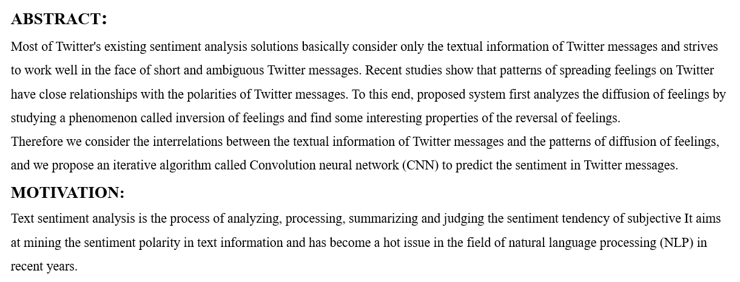
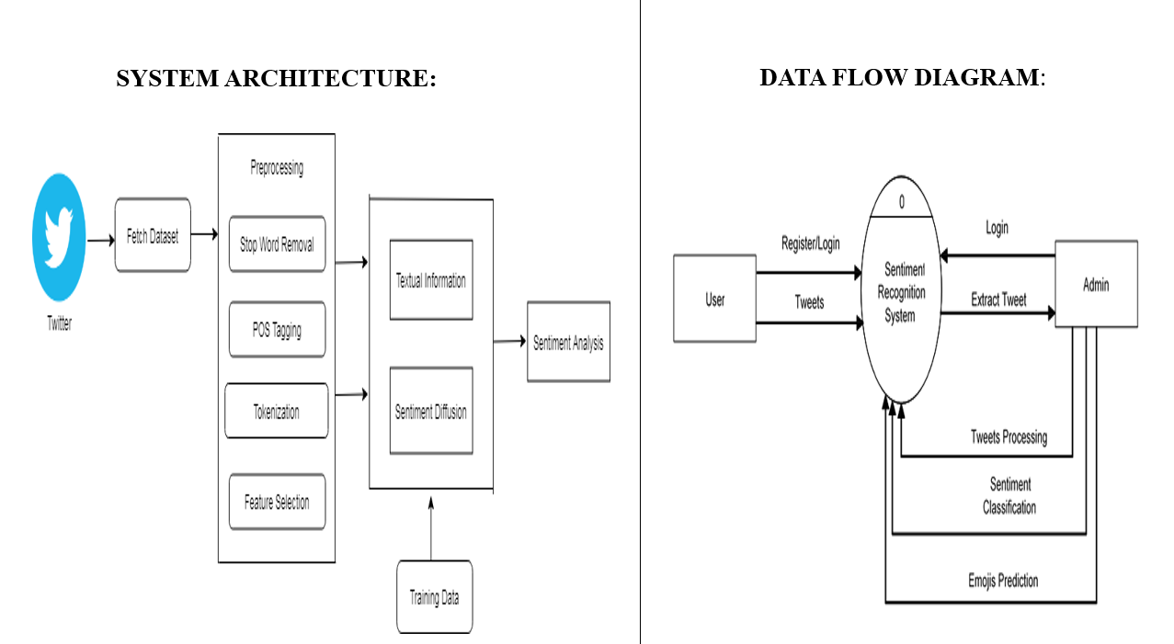
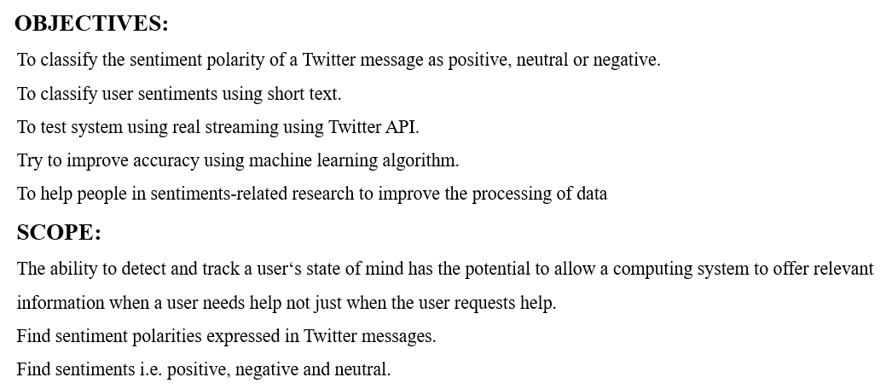



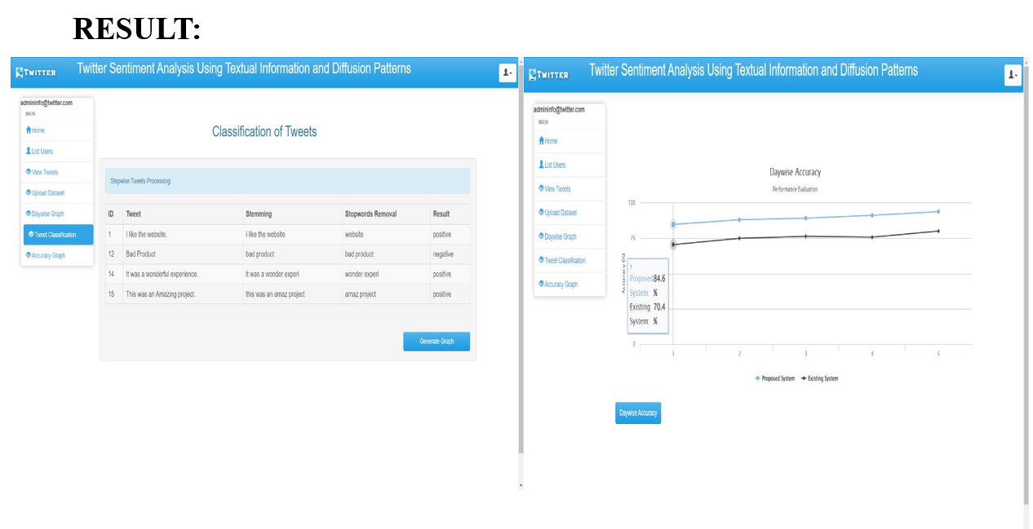
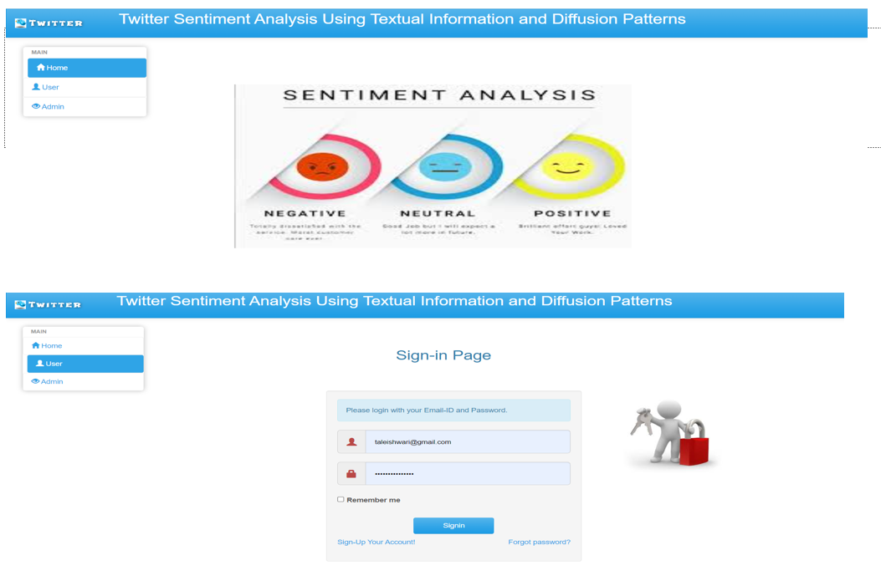
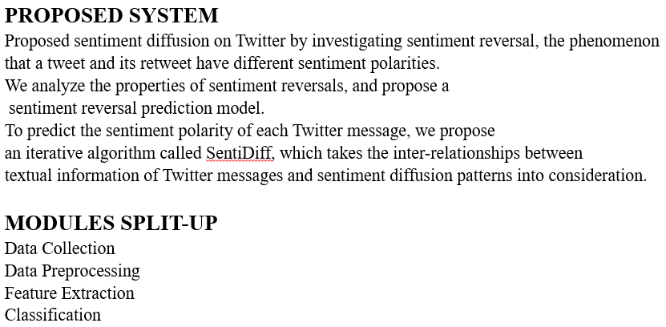
By: Ishwari Tale Guided by:
Aishwarya AherGawli R.Y.Totare
Abhijeet Girase
Ayushi Khanbard
SENTIMENT ANALYSIS USING RANDOM FOREST ALGORITHM

